Slide 1
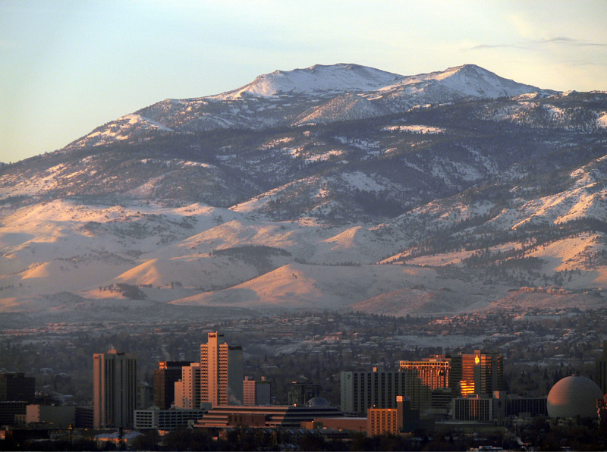
TMWRF – Learning from Experience
Jason Geddes, Ph.D.,
Environmental Services Administrator

Slide 2
Motivation
Deferred maintenance needs
No general funds available
Energy efficiency to reduce costs
Renewable energy commitment
U.S. Mayors Climate Agreement

Slide 3
Energy Projects
Centralized energy management
Outdoor lighting and streetlight upgrades
Water system upgrades
Pool covers
Boiler improvements at Swimming Pools
HVAC replacements

Slide 4
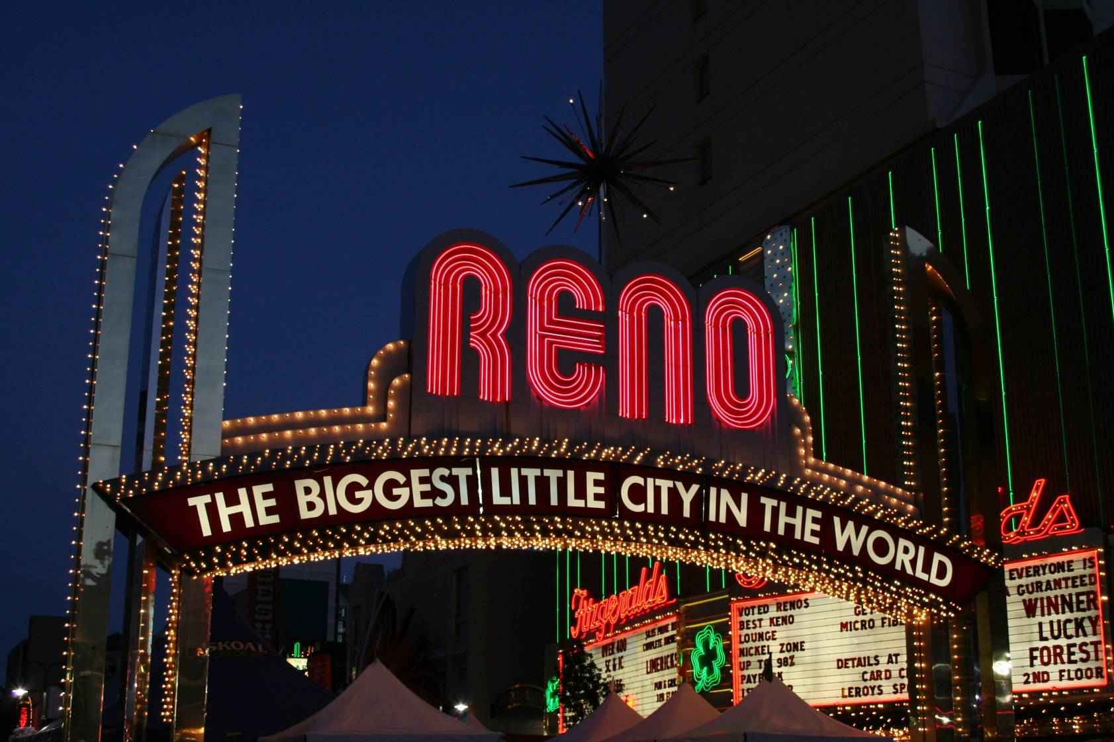
Reno Arch: 2,076 bulbs to LED

Slide 5
City Hall
Lighting systems
Chiller/Tower replacement
Boiler plant replacement
Control systems
$6,404,790
Reduce cost from ~$3.67 to ~$1.81 per square foot

Slide 6
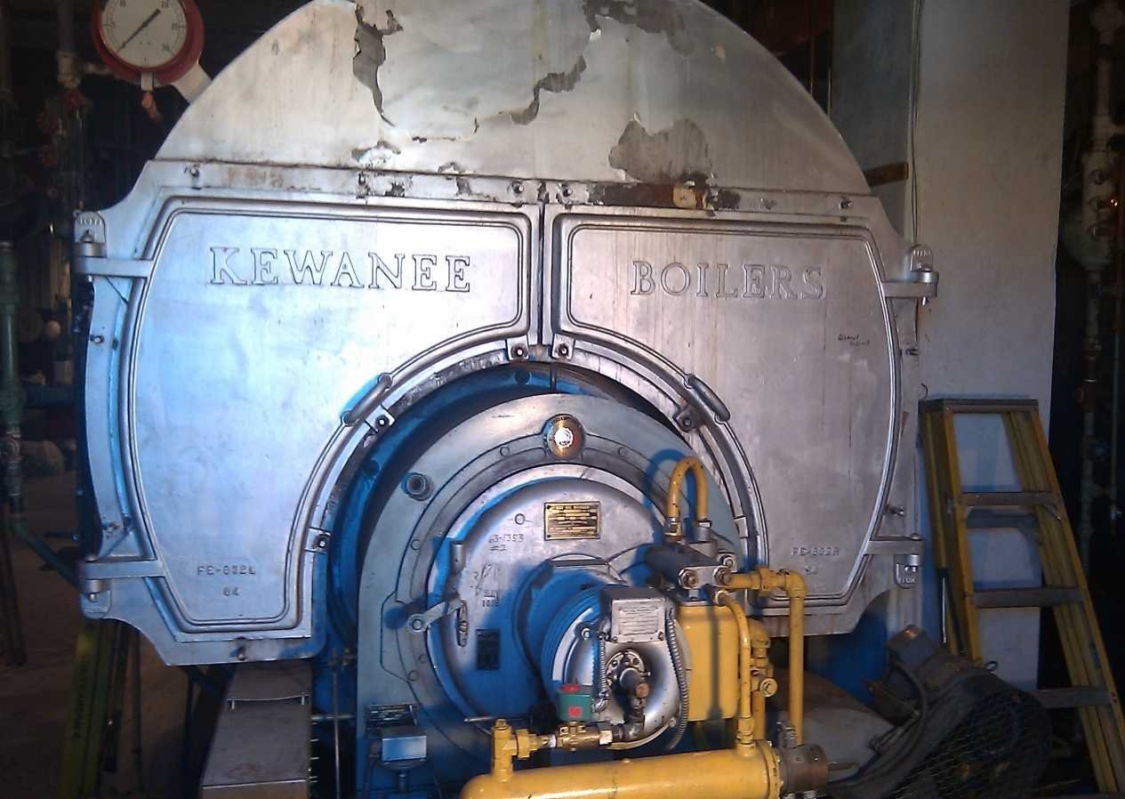
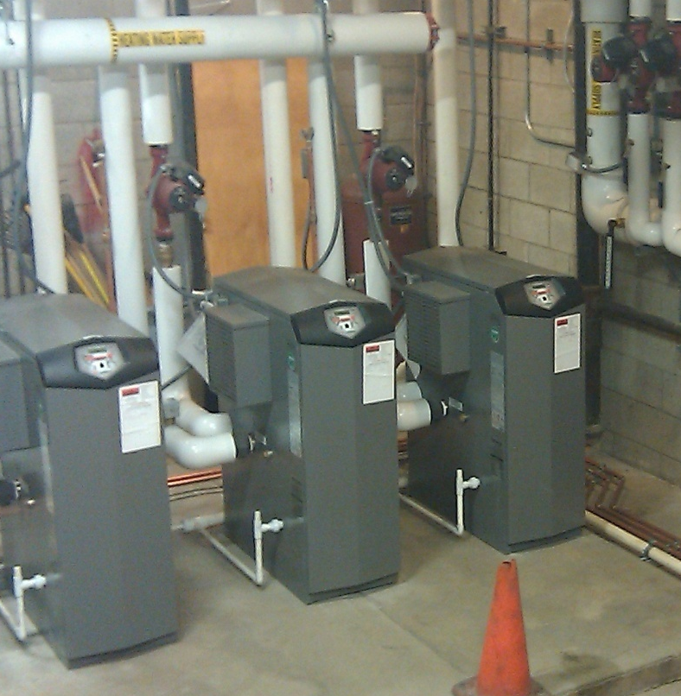
Older inefficient boiler vs. new energy efficient condensing boilers

Slide 7
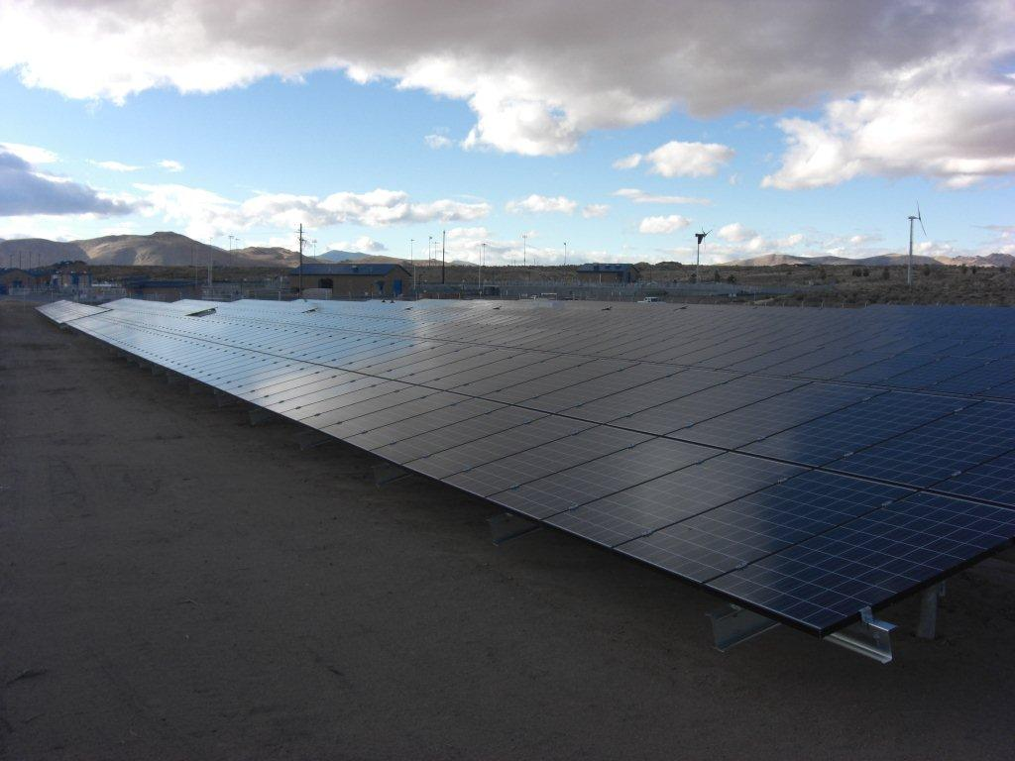
1,287 kW PV City-wide at 12 Locations Stead wastewater – 522kW
Notes:
7

Slide 8
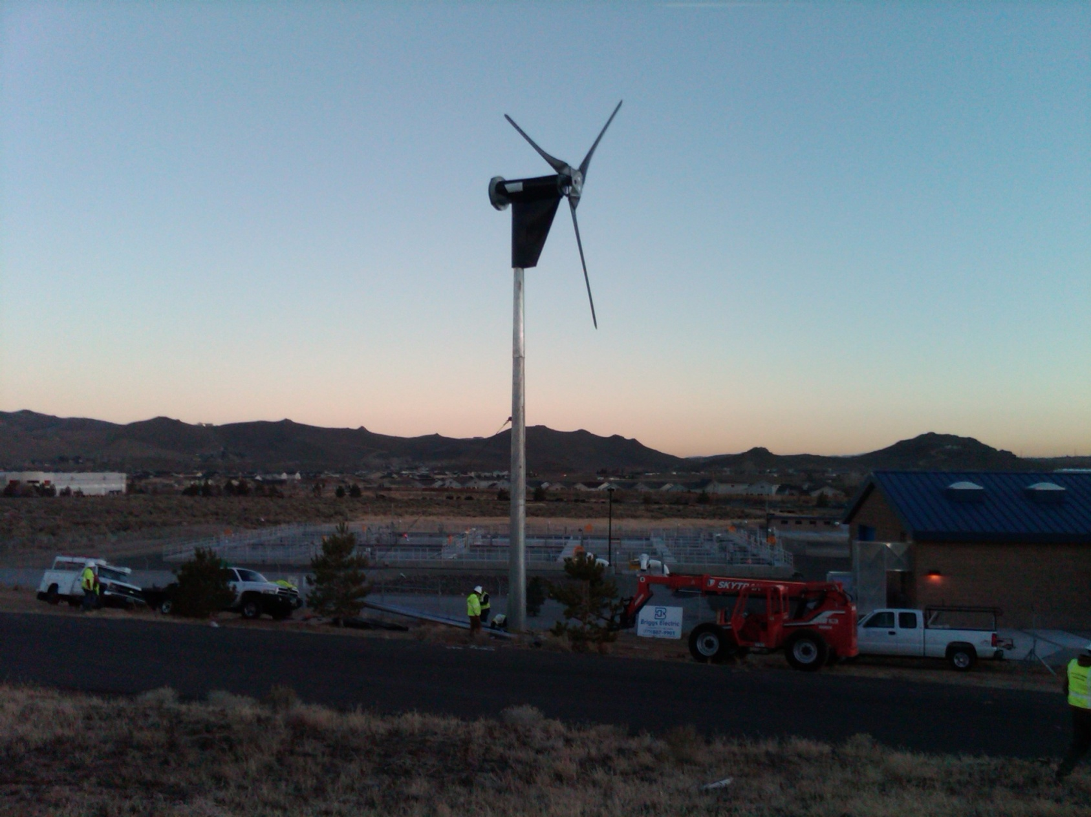
Stead Water Treatment Plant

Slide 9
Energy Projects
$19,257,112 in projects
$1,700,822 per year cost savings (-32%)
8,962,964 kWh/year energy savings (-41%)
Federal Grants & Utility Rebates
QECBs, CREBs, and RZEDs bonds paid back in guaranteed energy savings

Slide 10
Federal Grants & Utility Rebates
$2,142,800 Energy Efficiency Conservation Block Grants*
$156,400 WindGenerations
$1,608,660 SolarGenerations
$263,592 SureBet
$568,700 NSOE Grant
$4,740,152 Total

Slide 11
Financing
$2,261,645 Qualified Energy Conservation Bonds (QECBs)
$2,340,000 Clean & Renewable Energy Bonds (CREBs)
$10,860,000 Recovery Zone Economic Development Bonds (RZEDs)*
* - EECBG and RZEDs were part of ARRA and not available in future. Replace with municipal or ESCo financing.

Slide 12
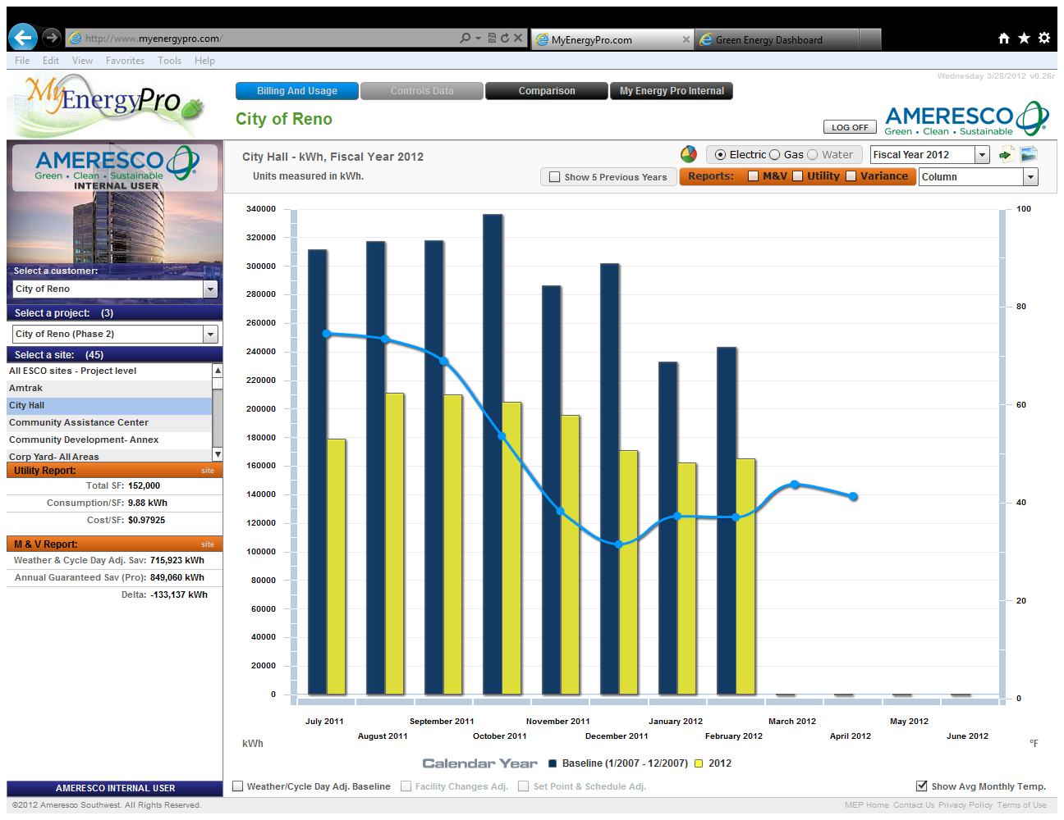

Slide 13
Savings as of June 30, 2013
 | Electricity | Natural Gas | Annual Energy Costs | Annual Cost Savings | Renewable Energy | Carbon Footprint
 | kWh | Therms | $ | $ | kWh | Pounds of CO2
FY2007 | 20,747,852 | 718,993 | $5,214,137 | - | - | 48,836,012
FY2008 | 21,805,944 | 767,343 | $5,360,822 | - | - | 51,980,811
FY2009 | 20,318,181 | 576,382 | $5,099,571 | $261,252 | - | 46,651,516
FY2010 | 19,124,499 | 653,074 | $4,850,374 | $510,448 | 205,675 | 40,664,551
FY2011 | 17,210,783 | 565,853 | $4,167,453 | $1,193,369 | 397,435 | 37,688,298
FY2012 | 14,179,267 | 510,935 | $3,773,728 | $1,583,094 | 1,914,684 | 31,273,360
FY2013 | 12,842,980 | 533,323 | $3,660,000 | $1,700,822 | 2,974,522 | 33,825,795

Slide 14
Accolades
National Resources Defense Council 22 smartest cities
Time.com -10 greenest things you didn’t know
Fast Company Magazine – United States of Innovation
SWEEP – Innovative Local Government Projects
Big Ideas for Job Creation – Energy Efficiency in Government Sector
Nevada EcoNet Golden Pinecone
10 Cities with Innovative Green Initiatives - NerdWallet
www.reno.gov
geddesj@reno.gov

Slide 15
TMWRF Motivation
CIP backlog of ~$98 million
Energy efficiency and chemical savings to reduce costs
Desired path to Net-zero energy
Nutrient discharge into Truckee River
Emissions reductions

Slide 16
Path to Energy Independence
Baseline energy use is 159,055 MMBTU per year
TMWRF is currently 34% energy independent through digester gas heat production
ESCO project will increase energy production by another 13%
  Potential future on-site electricity generation Install 2nd cogen engine (850 kW)
  FOG addition and 3rd cogen engine (1 MW)
  Large scale solar PV system (6 MW)
If all future projects are implemented, TMWRF could potentially achieve 96% energy independence

Slide 17
Energy Conservation Measures (ECMs)
ECM | Scope Summary | Cost
ECM 2-Centrate Nutrient Recovery | Construct a new prefab building Install one Pearl 2000 reactor and its appurtenances Tie-ins to plant’s utilities | $6,760,860
ECM 4A – Biogas Cogen | Demolish existing cogen system Install a new 850 kW cogen system (Jenbacher 320) | $5,116,967¹
ECM 4B – Digestor Dome | Repair digester covers #1 and #3 | $3,121,795²
ECM 6 – Dewatering upgrades | Replace 2 centrifuges (Alpha-Laval G2) Replace 2 cake pumps (Schwing-Bioset) Replace cake piping, valves, actuators Electrical, instrumentation, and controls work | $6,066,614
ECM 7 – Lighting upgrades | Upgrade 1,588 light fixtures | $428,761
ECM 9 – Near term Dewatering | Repair dewatered sludge hoppers Install new dewatering polymer system Upgrade HVAC and air purge systems Modification to alum and centrate piping | $3,005,202²
ECM 10 – My Energy Pro | MyEnergy Pro utility monitoring system | $50,625
 | Detailed Energy Audit | $149,835
 | Performance and Payment Bonds, Permits | $210,930
1 – Not in 5 year CIP, but needs to be. 2 – Already in 5 year CIP. | TOTAL | $24,911,589

Slide 18

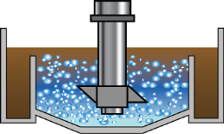


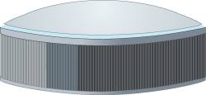


ECM 4: Biogas Cogeneration
Primary
Sludge
WAS
GTO
Gravity
Thickener
Dissolved
Air Flotation
DAFT Subnatant
Cogeneration
Gas Cleaning
Centrifuge
Acid Phase
Anaerobic
Digestion
Methane
Phase Anaerobic
Digestion
Centrate Recycle

Slide 19
Projects
$24,911,589 in projects
$1,122,887 per year cost savings
5,817,735 kWh/year energy savings
28,985 gallons methanol reduction
1,155 dry tons alum reduced
Reduced biosolids hauling and disposal

Slide 20
Project Benefits
• Operational Permit Compliance Benefits: Ostara nutrient recovery system lowers phosphorous (93%) and nitrogen (7%) for river discharge per TROA and NDEP regulations.
• Air Quality Permit Compliance: Cogeneration system included in reply to WCAQMD and EPA Region IX.
• Path to Energy independence: Plant will be nearly 50% net energy and provide renewable energy to NV Energy portfolio standard.
• Local Jobs and Economic Support: Local equipment distributors, local subcontractors, and local labor are 75%.
• Leverage Capital Expenditures: Use reserves to fund additional CIP projects beyond the approved 5 year CIP to yield lower operating costs.
• Lower Operating Costs: Reduce annual operating costs by at least $1.12 million/year.

